Slide 1
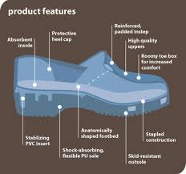
SEM1 1.05 A - Selling
PE - Acquire product knowledge to communicate product benefits and to ensure appropriateness of product for the customer
PI – Determine sport/event features and benefits
PI – Describe factors that motivate people to participate in/attend sport/events

Slide 2
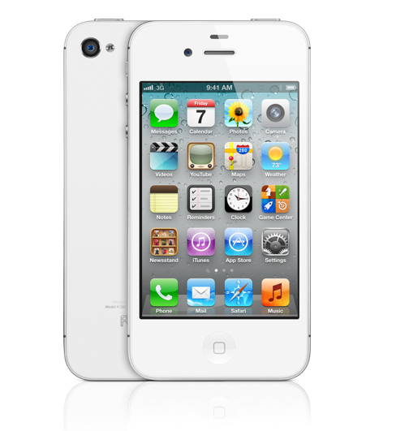
What do you see?

Slide 3

What do you see?

Slide 4
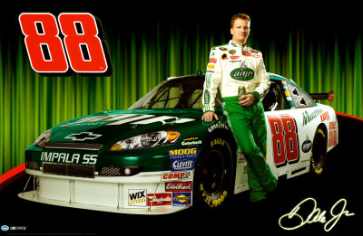
What do you see?

Slide 5
Feature and Benefit
Feature:
Describes an actual part of a product or service
Benefit:
Describes how a product or service will directly offer a user a solution
Answers the question “What’s in it for me?”
For every feature, there should be a corresponding benefit for a consumer

Slide 6
Define and Identify: Obvious Benefits and Unique Benefits
Obvious Benefits:
Easy to recognize
Example: Alloy Rims vs Factory Grade – Status Symbol
Example: 4G – Connectivity Availabiltiy
Example: NASCAR- 200+ MPH wins races!
Unique Benefits:
Specific to the product or service
Example: Iphone 4S “Suri” – Handsfree
Example: Victoria Beckham Edition – Exclusive style
Example: NASCAR – Safety seats – Specially made for the driver

Slide 7
Define and Identify: Hidden Benefits &Feature Benefit Selling
Hidden Benefits:
Implied but not obvious
Example: Hybrid Cars = Better gas mileage
Example: Sketchers Shape-Ups = Ergonomics
Example: NASCAR – Provided research for automobile creation and innovation
Feature Benefit Selling
Providing product features to satisfy consumers by offering them a benefit they need or want

Slide 8
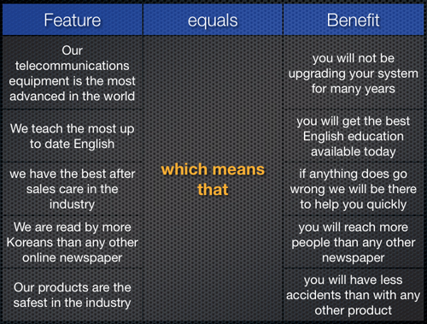
Feature-Benefit Chart

Slide 9
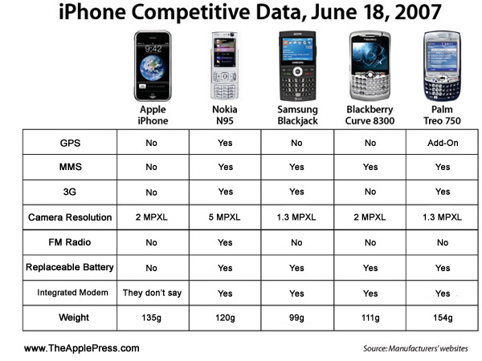
Feature-Benefit Chart Example

Slide 10



Identify sources of feature/benefit information
Consumer Reports
Company Websites
Angie’s List
Blogs
Government Websites (ie: FDA)
Social Media
Twitter

Slide 11

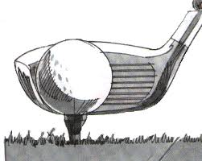
Distinguish between features and benefits for services versus those for tangible sport/event products
Service
Product
Example: Sports Spa/Gym
Features: Massages, Yoga Classes, Weight lifting classes
Benefits: Better health, fewer injuries, better performance
Example: Golf Clubs
Features: Loft, weight, graphite vs. steel, woods vs. irons
Benefits: Control, durability, backspin, low score

Slide 12
Describe how to prepare a feature-benefit chart for a product
Identify each feature
Align each feature with benefit(s)
Keeping in mind your target market/customers

Slide 13
Prepare a feature-benefit chart for a product
Feature | Benefit
Notes:
Teacher assigns product for students to use in filling out a chart

Slide 14
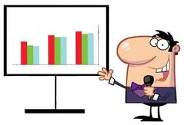


Explain the importance of understanding why people participate in/attend sports/events
Target marketing – help to key on your customers
Assist in market(ing) planning – where to market
Economic analysis
Health

Slide 15



Describe techniques for identifying sport/event motivators
Surveys
Social Media
Blogs
Face to face
Blind sampling
Focus groups
Promotions

Slide 16



Describe ways that salespeople can use sport/event motivators to sell products
Sample
Discounts
Testimonials
Endorsement
Exclusive
Prestige
Patronage

